Slide 1
SELF-CARE
REMINDERS

Slide 2
Remember you are not alone.
This is being felt around the world.
Everyone reacts differently to stressful situations
You may feel sad or anxious
Talking to people you trust & sharing how you feel can help

Slide 3
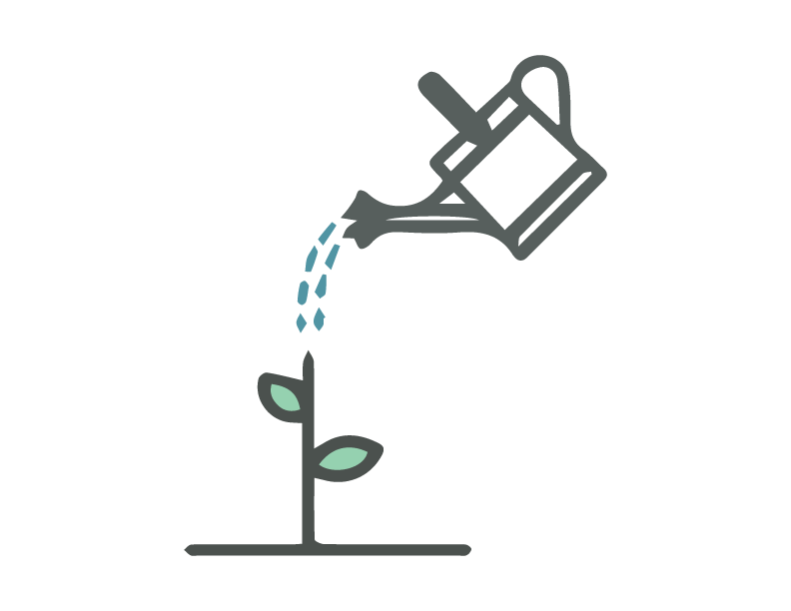
Take care of your body
Try to eat healthy well-balanced meals
Exercise regularly
Get plenty of sleep
Avoid alcohol & drugs
Make time to unwind
Try to do some other activities you enjoy
Take deep breaths, stretch, or use other strategies that have worked for you
Things you can do to cope with stress:

Slide 4
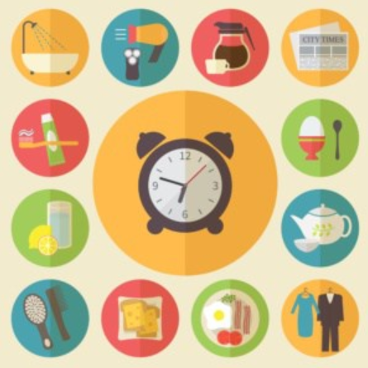
Trying to maintain some sort of routine can help to keep us grounded.
Get up at the same time
Set yourself tasks to complete
Make sure you include breaks, leisure activities & time to connect with friends and family
Designate times to check on news as well as device-free times
Notes:
We mentioned this earlier in the Q & A. But try and get up at the time you usually do (the rhythm your body is used to)
Have a shower etc, get dressed! (You can be in your casual clothes…but don’t fall into pajamas days).
7-9 hours sleep
Self grooming key!
Take breaks!

Slide 5
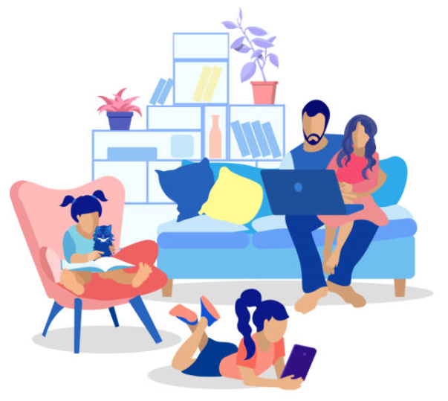
Tips for coping with extended time with family or housemates
Be aware of the needs of others in the household
Discuss schedules and use of spaces
If you need some time alone, flag this and let people know
Communicate your needs clearly and calmly

Slide 6
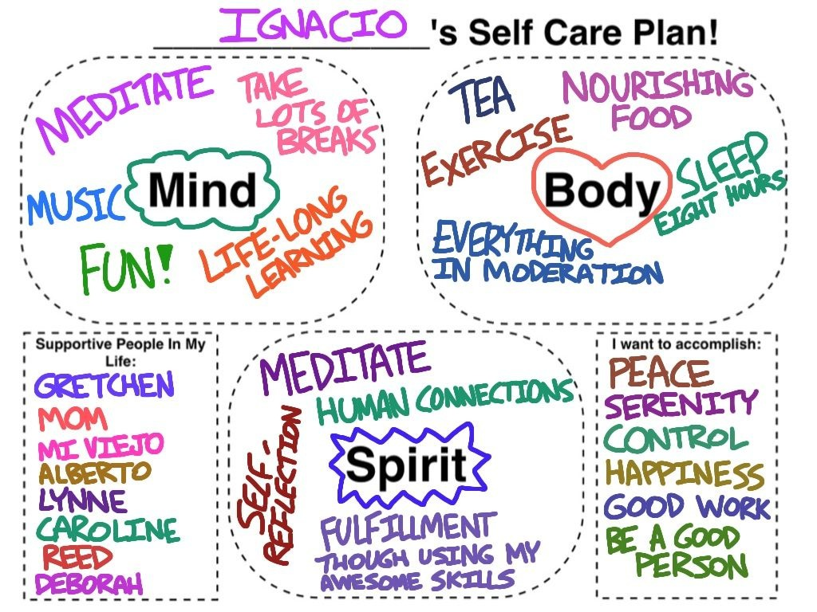
Try creating a
self-care plan
like Ignacio

Slide 7
Reach out for help
If you, or someone you care about
feel overwhelmed with emotions like sadness, fears and worries
feel life stress gets in the way of your daily routines
or feel like you want to harm yourself or others

Slide 8
Last but not least:
Try to be as gentle as possible with yourselves at this time.
Notes:
It’s okay to slow down too!

